Slide 1
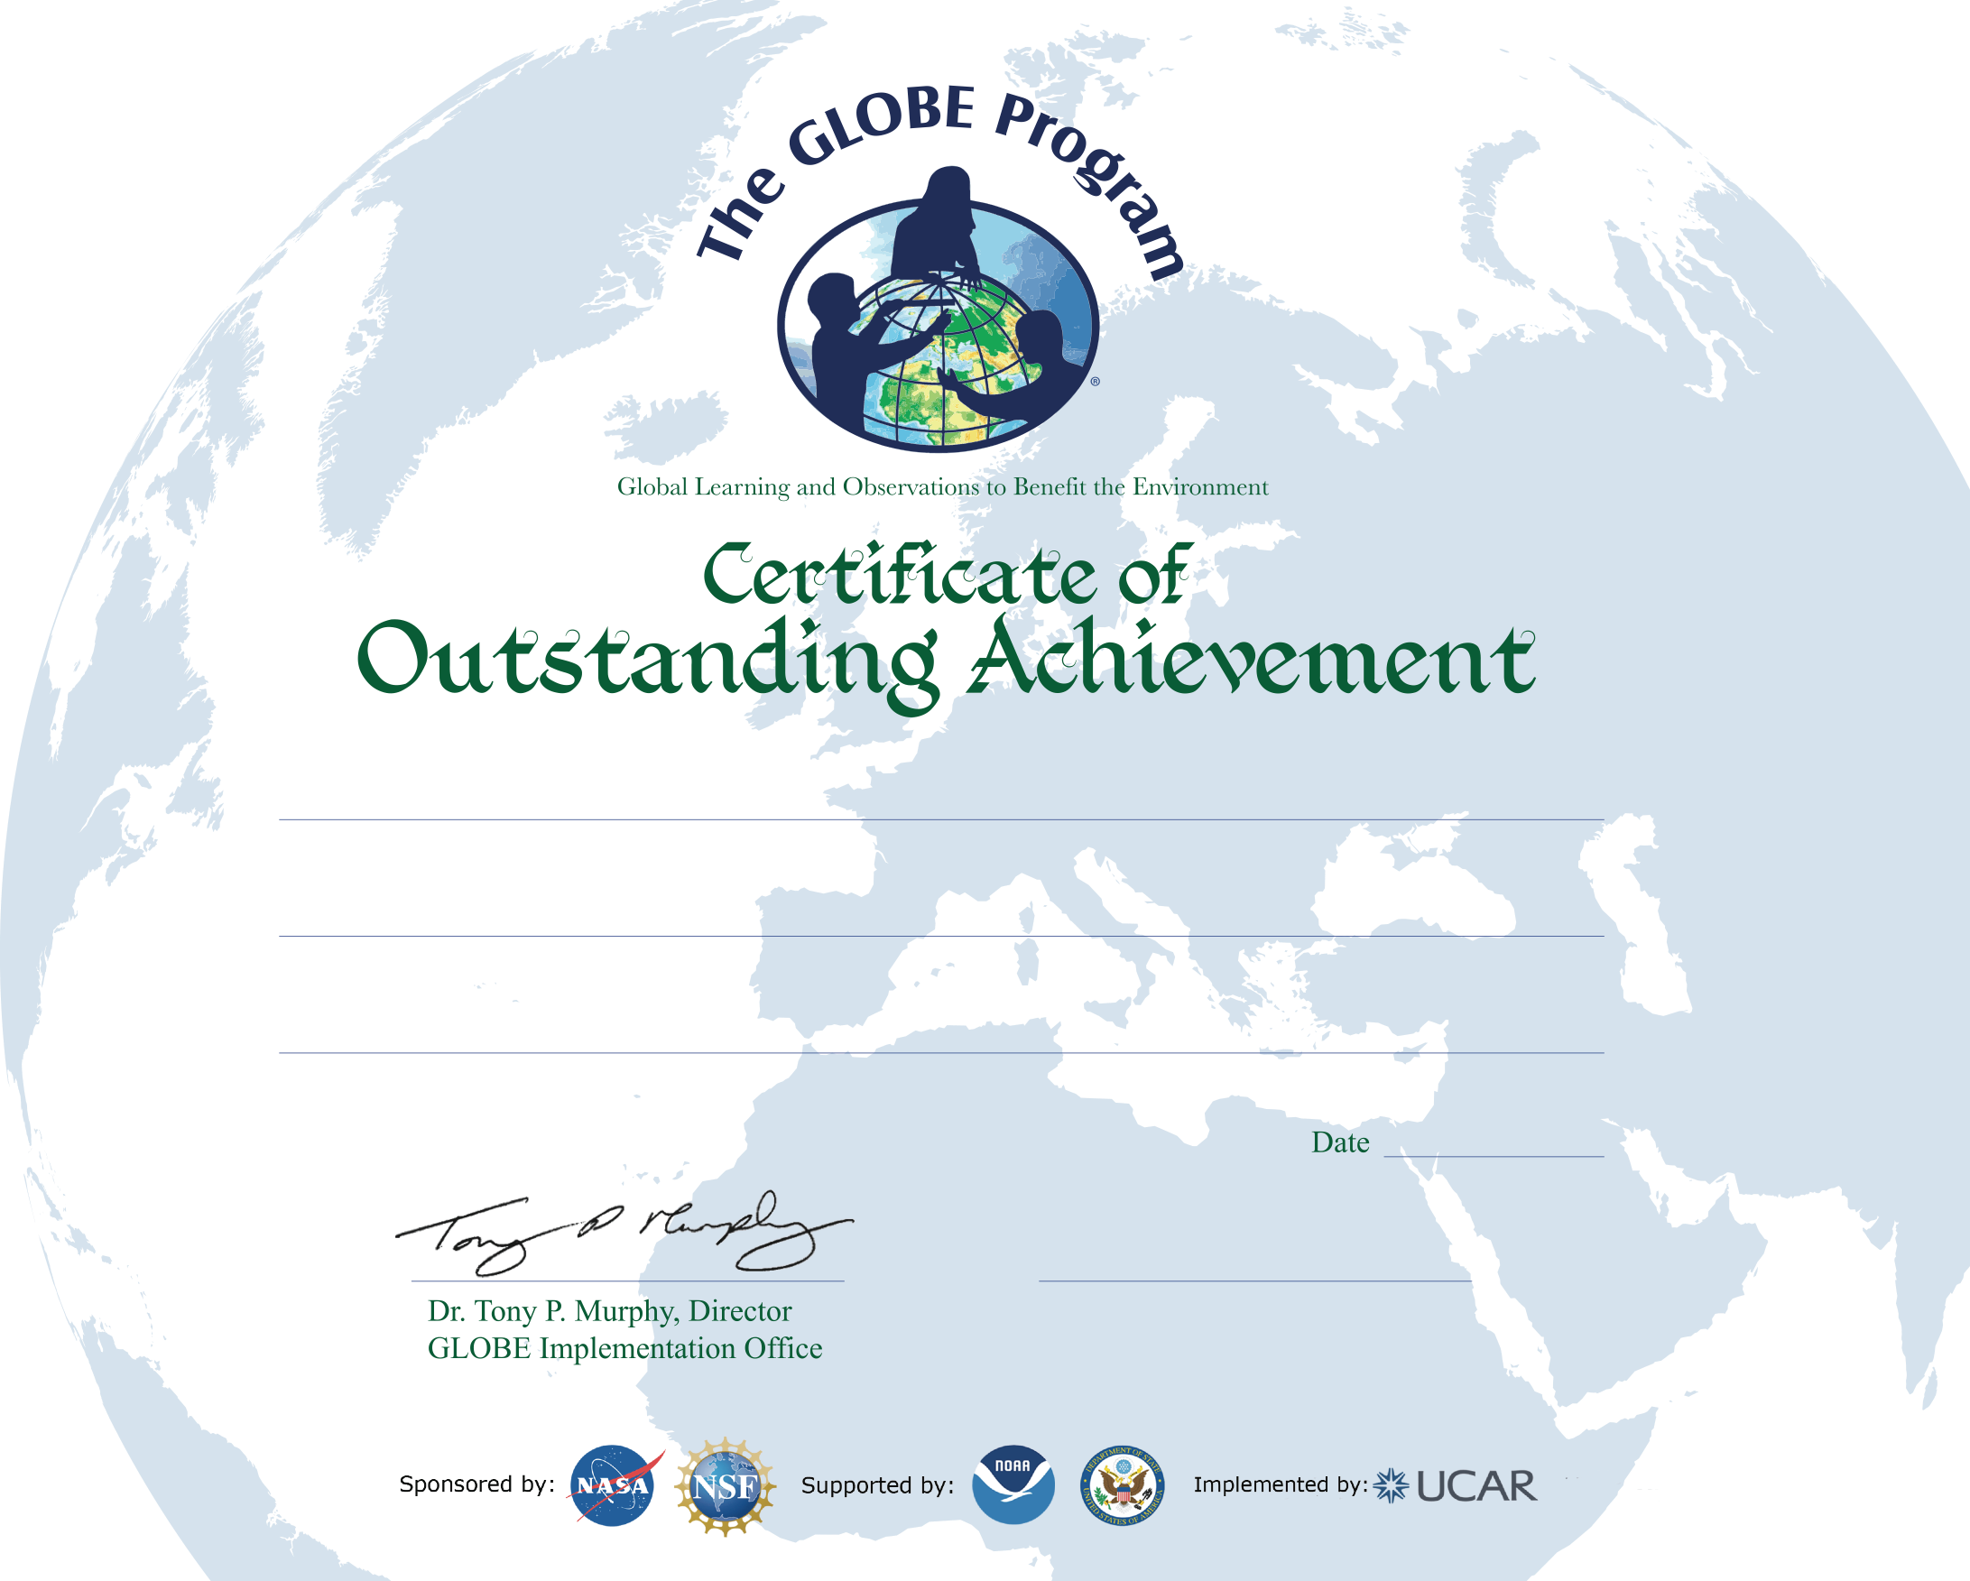
Ivano-Frankivsk City Environmental Station
GLOBE Science Honor Roll (Atmosphere)
Level II
21 September 2023
Dr. Volodymyr Verbytskyi, Director
National Ecology and Nature Center,
Ukraine
Наказ № 97 від 5 грудня 2023

Slide 2
Ivano-Frankivsk City Environmental Station
GLOBE Science Honor Roll (Phenology)
Level III
21 September 2023
Dr. Volodymyr Verbytskyi, Director
National Ecology and Nature Center,
Ukraine
Наказ № 97 від 5 грудня 2023

Slide 3
General Education Sanatorium Boarding School No. 19, Kyiv
GLOBE Science Honor Roll (Phenology)
Level III
21 September 2023
Dr. Volodymyr Verbytskyi, Director
National Ecology and Nature Center,
Ukraine
Наказ № 97 від 5 грудня 2023

Slide 4
City Center for Ecological and Naturalistic Creativity of Student Youth, Chernivtsi City Council
GLOBE Science Honor Roll (Phenology)
Level III
21 September 2023
Dr. Volodymyr Verbytskyi, Director
National Ecology and Nature Center,
Ukraine
Наказ № 97 від 5 грудня 2023

Slide 5
Ivano-Frankivsk City Environmental Station
GLOBE Science Honor Roll (Climate)
Level I
21 September 2023
Dr. Volodymyr Verbytskyi, Director
National Ecology and Nature Center,
Ukraine
Наказ № 97 від 5 грудня 2023

